Slide 1
NEPTUNE RECORDS
IS 183

Slide 2
PROJECT RESPONSIBILITIES
Team Lead: Jor-El Sanchez
Frontend Developer: Omar Benavides
Backend Developer: Karandeep Gill
Database Administrator: David Patterson

Slide 3
TASK
Our team is to build a website for a client looking to expand their business into the online market. The website is to list various products that the business sells via picture and description.

Slide 4
PROBLEM
Currently, the client does not have a website or webpage for their business.
The client would like the website to utilize social media to communicate with customers, spread word of their business, as well as offer deals.
The website would need to be search engine optimized.
The client will also need a database for their growing business. This database will keep track of items, orders, prices, and descriptions. The database will allow for products to be searched by genre and artist name.

Slide 5
SOLUTION TO PROBLEM
Create a website for Neptune Records
Website that will consist of:
Link to their Facebook page
Link to their Instagram page
Information about the music store and how it was started
Gallery of rare records and new and upcoming records
A feature through which clients can send emails to customer service
A page for past events and upcoming events

Slide 6
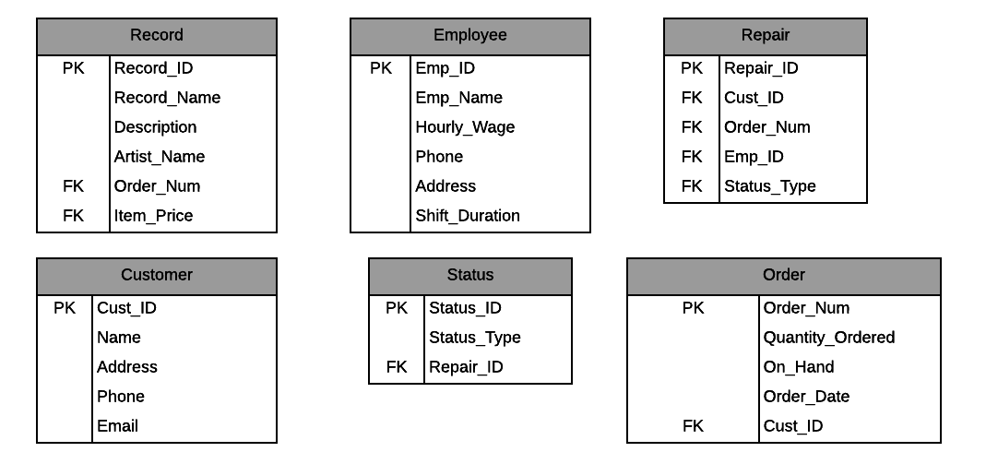
TABLES

Slide 7
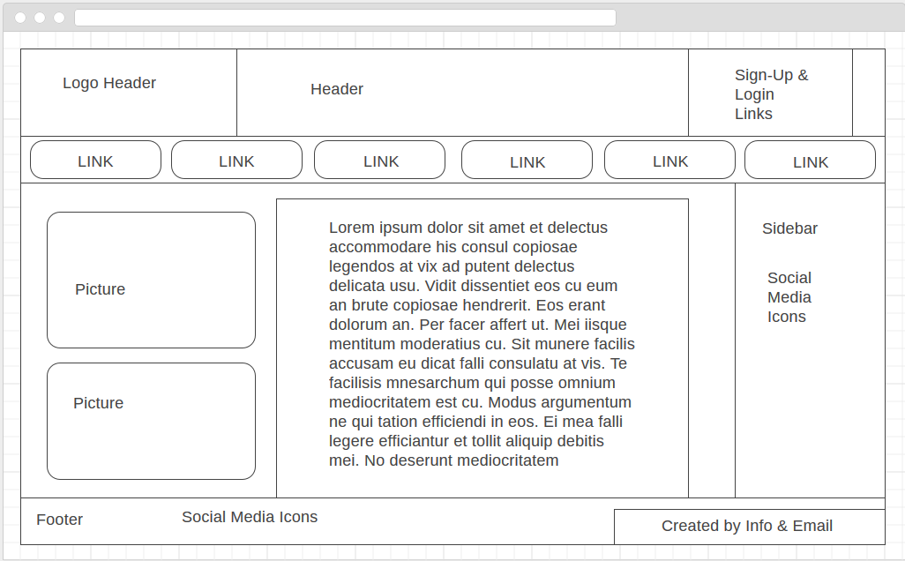
MVP - WIREFRAME

